Slide 1
Normalization

Slide 2
Normalization
The biggest problem needed to be solved in database is data redundancy.
Why data redundancy is the problem? Because it causes:
  Insert Anomaly
  Update Anomaly
  Delete Anomaly

Slide 3
What is an Anomaly?
Definition
  Database anomaly is normally the flaw in databases which occurs because of poor planning and storing everything in a flat database(single table).
  3 types
    Insert
    Delete
    Update

Slide 4
Insert Anomaly
An Insert Anomaly occurs when certain attributes cannot be inserted into the database without the presence of other attributes.

Slide 5
Insert Anomaly
Course _no | Trainer | Room | Room_size | En_limit
C001 | Raj | R001 | 45 | 40
C002 | Seeta | R002 | 100 | 60
C003 | Meeta | R003 | 400 | 300
C004 | Veeta | R003 | 400 | 45
e.g. we have built a new room (e.g. R004) but it has not yet been timetabled for any courses or members of staff.

Slide 6
Delete Anomaly
A Delete Anomaly exists when certain attributes are lost because of the deletion of other attributes.

Slide 7
Delete Anomaly
Course_no | Tutor | Room | Room_size | En_limit
C001 | Raj | R001 | 45 | 40
C002 | Seeta | R002 | 100 | 60
C003 | Meeta | R003 | 400 | 300
C004 | Veeta | R003 | 400 | 45
e.g. if we remove the entity, course_no:C004 from the above table, the details of room R003 get deleted. Which implies the corresponding course will also get deleted.

Slide 8
Update Anomaly
An Update Anomaly exists when one or more instances of duplicated data is updated, but not all.

Slide 9
Update Anomaly
Course_no | Trainer | Room | Room_size | En_limit
C001 | Raj | R001 | 45 | 40
C002 | Seeta | R002 | 100 | 60
C003 | Meeta | R003 | 400 | 300
C004 | Veeta | R003 | 400 | 45
e.g. Room R003 has been improved, it is now of RSize = 500. For updating a single entity, we have to update all other columns where room=R003.

Slide 10
Normalization (Cont.)
Normalization is the process of removing redundant data from your tables to improve storage efficiency, data integrity, and scalability.
Normalization generally involves splitting existing tables into multiple ones, which must be re-joined or linked each time a query is issued.
Why normalization?
  The relation derived from the user view or data store will most likely be unnormalized.
  The problem usually happens when an existing system uses unstructured file, e.g. in MS Excel.

Slide 11
Steps of Normalization
First Normal Form (1NF)
Second Normal Form (2NF)
Third Normal Form (3NF)
Boyce-Codd Normal Form (BCNF)
Fourth Normal Form (4NF)
Fifth Normal Form (5NF)
In practice, 1NF, 2NF, and 3NF are enough for database.

Slide 12
First Normal Form (1NF)
The official qualifications for 1NF are:
  Each attribute name must be unique.
  Each attribute value must be single.
  Each row must be unique.
  There is no repeating groups.
Additional:
  Choose a primary key.
Reminder:
A primary key is unique, not null, unchanged. A primary key can be either an attribute or combined attributes.

Slide 13
First Normal Form (1NF) (Cont.)
Example of a table not in 1NF :
It violates the 1NF because:
Attribute values are not single.
Repeating groups exists.
Group | Topic | Student | Score
Group A | Intro MongoDB, Oracle | Raj Deep | 18 marks
 |  | Ram Kumar | 28 marks
 |  | Seeta Kumari | 17 marks
Group B | Intro MySQL | Ram Patil | 19 marks
 |  | Veeta Roy | 16 marks

Slide 14
First Normal Form (1NF) (Cont.)
After eliminating:
Group | Topic | First Name | Last Name | Score
A | Intro MongoDB | Raj | Deep | 18
A | Intro MongoDB | Seeta | Kumari | 17
A | Oracle | Raj | Deep | 18
A | Oracle | Seeta | Kumari | 17
B | Intro MySQL | Ram | Patil | 19
B | Intro MySQL | Veeta | Roy | 16

Slide 15
First Name | Last Name | Score | GroupId
Raj | Deep | 18 | A
Seeta | Kumari | 17 | A
Ram | Patil | 19 | B
Veeta | Roy | 16 | B
Raj | Deep | 18 | C
Seeta | Kumari | 17 | C
Group | Technology
A | Intro Mongo DB
B | Intro MySQL
C | Oracle
Now it is in 1NF.
However, it might still violate 2NF and so on.

Slide 16
Functional Dependencies
We say an attribute, B, has a functional dependency on another attribute, A, if for any two records, which have
the same value for A, then the values for B in these two records must be the same. We illustrate this as:
  A → B (read as: A determines B or B depends on A)
Employee name | Project | Email address
Raj Deep | Java | raj@gmail.com
Seeta Kumari | .net | seeta@gmail.com
Ram Patil | HTML5/CSS3 | ram@gmail.com
Veeta Roy | Database | veeta@gmail.com
Raju Patel | DB Design | raju@gmail.com
    Employee name → Email address
    Employee name determines Email Address
    Email Address depends on Employee name

Slide 17
Functional Dependencies (cont.)
EmpNum
EmpEmail
EmpFname
EmpLname
123
raj@gmail.com
Raj
Deep
456
seeta@gmail.com
Seeta
Kumari
555
ram@gmail.com
Ram
Patil
633
veeta@gmail.com
Veeta
Roy
787
raju@gmail.com
Raju
Patel
If EmpNum is the PK then the FDs:
EmpNum → EmpEmail, EmpFname, EmpLname
must exist.

Slide 18
Functional Dependencies (cont.)
EmpNum → EmpEmail, EmpFname, EmpLname
3 different ways you might see FDs depicted
EmpEmail
EmpNum
EmpFname
EmpLname
EmpNum EmpEmail EmpFname EmpLname

Slide 19
Determinant
Functional Dependency
EmpNum → EmpEmail
Attribute on the left hand side is known as the determinant
  EmpNum is a determinant of EmpEmail

Slide 20
Second Normal Form (2NF)
The official qualifications for 2NF are:
A table is already in 1NF.
All non-key attributes are fully dependent on the primary key.
All partial dependencies are removed to place in another table.
12

Slide 21


Example of a table not in 2NF:
CourseID | SemesterID | Num Student | Course Name
IT101 | 201301 | 25 | Database
IT101 | 201302 | 25 | Database
IT102 | 201301 | 30 | Web Prog
IT102 | 201302 | 35 | Web Prog
IT103 | 201401 | 20 | Networking
Primary Key(Composite Key)
The Course Name depends on only CourseID, a part of the primary key
not the whole primary {CourseID, SemesterID}.It’s called partial dependency.
Solution:
Remove CourseID and Course Name together to create a new table.

Slide 22
CourseID | Course Name
IT101 | Database
IT101 | Database
IT102 | Web Prog
IT102 | Web Prog
IT103 | Networking
CourseID | SemesterID | Num Student
IT101 | 201301 | 25
IT101 | 201302 | 25
IT102 | 201301 | 30
IT102 | 201302 | 35
IT103 | 201401 | 20
Done? Oh no, it is still not in 1NF yet.
Remove the repeating
groups too.
Finally, connect the relationship.
Semester
CourseID | Course Name
IT101 | Database
IT102 | Web Prog
IT103 | Networking

Slide 23
CS_ID(PK) | CourseID(FK) | SemesterID(FK) | Num Student
CS001 | IT101 | 201301 | 25
CS002 | IT101 | 201302 | 25
CS003 | IT102 | 201301 | 30
CS004 | IT102 | 201302 | 35
CS005 | IT103 | 201401 | 20
Semester
SemesterID(PK) | Semester
201301 | I
201302 | II
201401 | III
201402 | IV
201501 | V
CourseID(PK) | Course Name
IT101 | Database
IT102 | Web Prog
IT103 | Networking

Slide 24
Third Normal Form (3NF)
The official qualifications for 3NF are:
A table is already in 2NF.
Nonprimary key attributes do not depend on other nonprimary key attributes
(i.e. no transitive dependencies)
  All transitive dependencies are removed to place in another table.

Slide 25


Example of a Table not in 3NF:
TeacherID | Teacher Name | Teacher Tel | Course Name
1 | Raj Deep | 012 123 456 | Database
2 | Seeta Kumari | 0977 322 111 | Database
3 | Ram Patil | 012 412 333 | Web Prog
4 | Seeta Kumari | 0977 322 111 | Web Prog
5 | Raj Deep | 012 123 456 | Networking
The Teacher Tel is a nonkey attribute, and
the Teacher Name is also a nonkey atttribute.
But Teacher Tel depends on Teacher Name.
It is called transitive dependency.
Primary Key
Solution:
Remove Teacher Name and Teacher Tel together
to create a new table.

Slide 26
Done?
Oh no, it is still not in 1NF yet.
Remove Repeating row.
Teacher Name | Teacher Tel
Raj Deep | 012 123 456
Seeta Kumari | 0977 322 111
Ram Patil | 012 412 333
Veeta Roy | 012 412 333
Raj Deep | 012 123 456
Seeta Kumari | 0977 322 111
StudyID | Course Name | T.ID(FK)
1 | Database | T1
2 | Database | T2
3 | Web Prog | T3
4 | Web Prog | T3
5 | Networking | T4
Teacher Name | Teacher Tel
Raj Deep | 012 123 456
Seeta Kumari | 0977 322 111
Ram Patil | 012 412 333
Veeta Roy | 077 545 221
Note about primary key:
In theory, you can choose
Teacher Name to be a primary key.
But in practice, you should add
Teacher ID as the primary key.
ID(PK) | Teacher Name | Teacher Tel
T1 | Raj Deep | 012 123 456
T2 | Seeta Kumari | 0977 322 111
T3 | Ram Patil | 012 412 333
T4 | Veeta Roy | 077 545 221

Slide 27
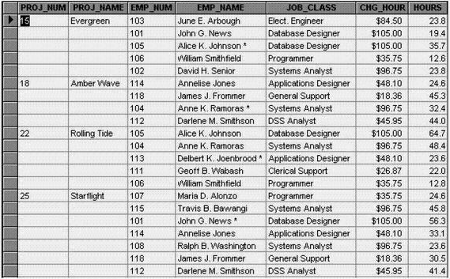

Slide 28
The project number is intended to be a primary key, but it contains nulls.The table displays data redundancies.
The table entries invite data inconsistencies.
The data redundancies yield the following anomalies:
Update anomalies. Modifying JOB_Class for an employee requires multiple alterationsAddition anomalies: New employees must be assigned to a project
Deletion anomalies: If an employee leaves all information associated with the employee is lost. If the employee is the only one working on a particular project all information on that project is lost.

Slide 29
Conversion to 1NF
A relational table must not contain repeating groups.Repeating groups can be eliminated by adding the appropriate entry in at least the primary key column(s).
This leads to a much wider, longer table
Until 1NF is achieved we cannot create a relational database at all.

Slide 30
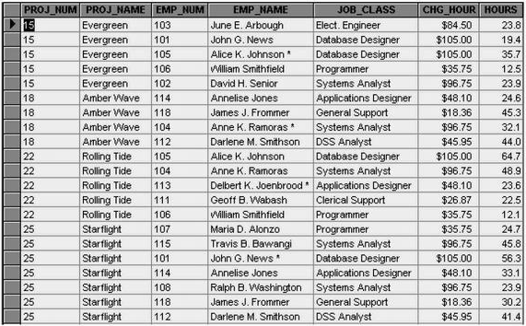

Slide 31
Dependency Diagram
In order to normalize a database it is essential to understand its dependencies.
Dependencies are based on the Business Rules that apply. The primary key components are bold, underlined, and shaded in a different color.
The arrows above entities indicate all desirable dependencies, in this table i.e., dependencies that are based on PK.
The arrows below the dependency diagram indicate less desirable dependencies -- partial dependencies (not based on entire PK) and transitive dependencies.

Slide 32
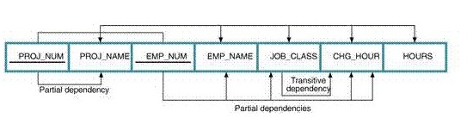

Slide 33
1NF and 2NF
1NF Definition
The term first normal form (1NF) describes the tabular format in which: All key attributes are defined. There are no repeating groups in the table.
All attributes are dependent on the primary key.
Second Normal Form
A table is in 2NF if : It is in 1NF and It includes no partial dependencies; that is, no attribute is dependent on only a portion of the primary key.

Slide 34
Conversion to Second Normal Form
Starting with the 1NF format, the database can be converted into the 2NF format by Writing each key component on a separate line, and then writing the original key on the last line and Writing the dependent attributes after each new key.
  PROJECT (PROJ_NUM, PROJ_NAME)
  EMPLOYEE (EMP_NUM, EMP_NAME, JOB_CLASS, CHG_HOUR)
  ASSIGN (PROJ_NUM, EMP_NUM, HOURS)

Slide 35
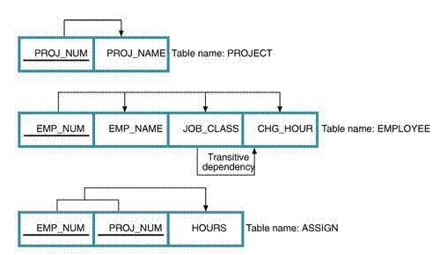
Conversion Results

Slide 36
3NF
Third Normal Form
A table is in Third Normal Form (3NF)
If : It is in 2NF
It contains no transitive dependencies

Slide 37
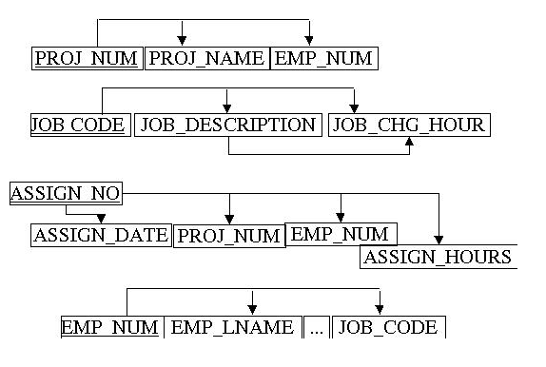

Slide 38
Conversion to Third Normal Form
Create a separate table with for each set of attributes in a transitive functional dependence relationship
  PROJECT (PROJ_NUM, PROJ_NAME)
  ASSIGN (PROJ_NUM, EMP_NUM, HOURS)
  EMPLOYEE (EMP_NUM, EMP_NAME, JOB_CLASS)
  JOB (JOB_CLASS, CHG_HOUR)

Slide 39
Boyce Codd Normal Form (BCNF) – 3.5NF
The official qualifications for BCNF are:
A table is already in 3NF.
All determinants must be superkeys.
All determinants that are not superkeys are removed to place in another table.

Slide 40

Boyce Codd Normal Form (BCNF) (Cont.)
Example of a table not in BCNF:
Key: {Student, Course}
Functional Dependency:
  {Student, Course}→ Teacher
  Teacher → Course
Problem: Teacher is not a superkey but determines Course.
Student | Course | Teacher
Raj | DB | Akash
Seeta | DB | Kishor
Ram | Java | Panakj
Veeta | Java | Akash
Raju | DB | Anand
Primary Key

Slide 41
Solution: Decouple a table contains Teacher and Course from from original table (Student, Course). Finally, connect the new and old table to third table contains Course.
SID(PK) | Student | Course
S001 | Raj | C002
S002 | Seeta | C002
S003 | Ram | C001
S004 | Veeta | C001
S005 | Raju | C002
CID(PK) | Course
C001 | Java
C002 | DB
Student Table
TID(PK) | Course(FK) | Teacher
T001 | C002 | Akash
T002 | C002 | Kishor
T003 | C001 | Pankaj
Course Table
Teacher Table

Slide 42
Forth Normal Form (4NF)
The official qualifications for 4NF are:
A table is already in BCNF.
A table contains no multi-valued dependencies.
Multi-valued dependency: MVDs occur when two or more independent multi valued facts about the same attribute occur within the same table.
A →→ B (B multi-valued depends on A)

Slide 43
Forth Normal Form (4NF) (Cont.)
Example of a table not in 4NF:
Key: {Student, Major, Hobby}
MVD: Student →→ Major, Hobby
Student | Major | Hobby
Seeta | IT | Football
Seeta | IT | Volleyball
Reeta | IT | Football
Reeta | Med | Football
Meeta | IT | NULL
Veeta | NULL | Football
Keeta | NULL | NULL

Slide 44
Solution: Decouple to each table contains MVD. Finally, connect each to a third table contains Student.
Student | Major
Seeta | IT
Reeta | IT
Reeta | Med
Meeta | IT
Keeta | NULL
Veeta | NULL
Student
Seeta
Reeta
Meeta
Keeta
Veeta
Student | Hobby
Reeta | Football
Reeta | Volleyball
Seeta | Football
Meeta | NULL
Veeta | Football
Keeta | NULL

Slide 45
Fifth Normal Form (5NF)
The official qualifications for 5NF are:
A table is already in 4NF.
The attributes of multi-valued dependencies are related.

Slide 46
Fifth Normal Form (5NF) (Cont.)
Example of a table not in 5NF:
Key: {Seller, Company, Product}
MVD: Seller →→ Company, Product
Product is related to Company.
Seller | Company | Product
Seeta | MIAF Trading | Zenya
Reeta | Coca-Cola Corp | Coke
Reeta | Coca-Cola Corp | Fanta
Reeta | Coca-Cola Corp | Sprite
Veeta | Angkor Brewery | Angkor Beer
Veeta | Cambodia Brewery | Cambodia Beer

Slide 47
Seller | Company
Seeta | MIAF Trading
Reeta | Coca-Cola Corp
Veeta | Angkor Brewery
Veeta | Cambodia Brewery
Company
MIAF Trading
Coca-Cola Corp
Angkor Brewery
Cambodia Brewery
Seller
Seeta
Reeta
Veeta
1
M
1
1
1
M
M
1
Company | Product
MIAF Trading | Zenya
Coca-Cola Corp | Coke
Coca-Cola Corp | Fanta
Coca-Cola Corp | Sprite
Angkor Brewery | Angkor Beer
Cambodia Brewery | Cambodia Beer
Seller | Product
Seeta | Zenya
Reeta | Coke
Reeta | Fanta
Reeta | Sprite
Veeta | Angkor Beer
Veeta | Cambodia Beer
M
Product
Zenya
Coke
Fanta
Sprite
Angkor Beer
Cambodia Beer
M
1

